Slide 1

Introduction to Data Science Project
UE18CS203
Time Series Analysis of Amazon Products
Team:
Samyak S Sarnayak
S Sai Rahul
Chirag Ganti

Slide 2
Introduction
This project deals with the analysis of Amazon products
Amazon product prices and other details vary a lot with time
Product details are scraped from Amazon India over a period of few months
Analysis is done for each product

Slide 3
Scope
01
A customer can know the best time to buy a product - before, during or after a sale
02
A company can understand how their product prices, ratings, offers etc. are varying.

Slide 4
Motivation
E-commerce product prices vary considerably over time. Knowing when to buy a product can help a consumer save money. It can be difficult to decide if a product should be bought at that point of time, or if the price will decrease or increase further.
There is a lack of analysis of Amazon product data, especially Amazon India products. We want to show how the product prices and other details vary over time - before, during and after a sale.

Slide 5
Description
The data is collected by performing web scraping on amazon.in
Details of 10 products are scraped periodically over the course of a few months
Web scraper is made using Scrapy library of python
A PostgreSQL database is used to store the data
The scraper and database are deployed to Heroku
The data consists of 29 columns
The dataset does not have a fixed number of rows. As of 18-11-19, the dataset contains 1918 rows

Slide 6
Cleaning and Normalising

Slide 7
Cleaning the Dataset
Data scientists spend a large amount of their time cleaning datasets and getting them down to a form which they can work.
Our dataset had a lot of missing values because not every product page has every detail, and most details were not available when the product was out of stock.
Some products were always out of stock throughout the whole time period
Some product’s names changed during the time period
The time of scraping was in UTC timezone instead of IST
Price data was not normalized

Slide 8
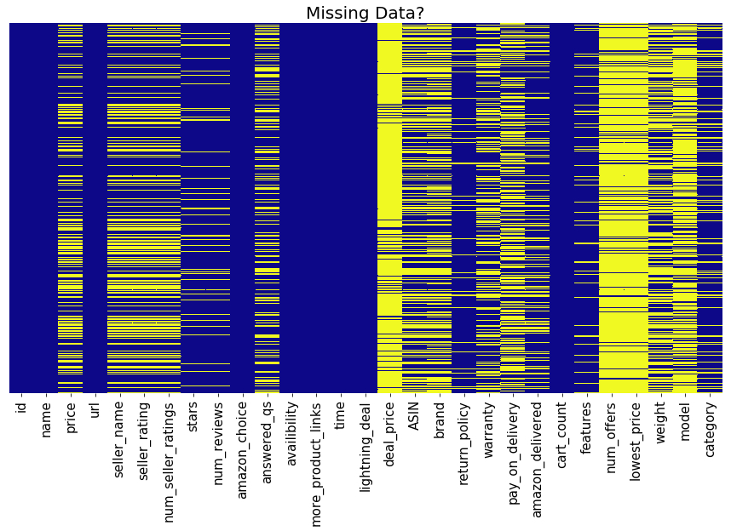

Slide 9
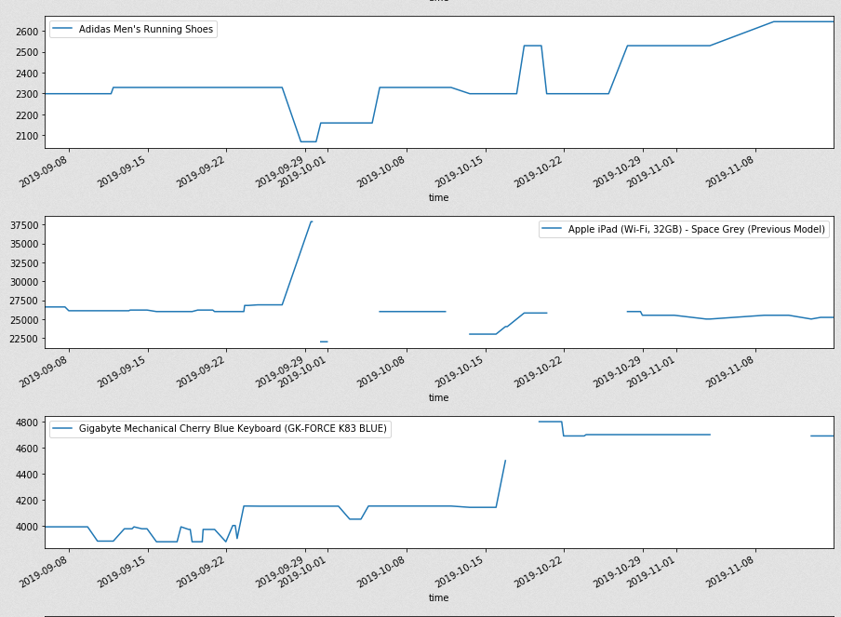

Slide 10
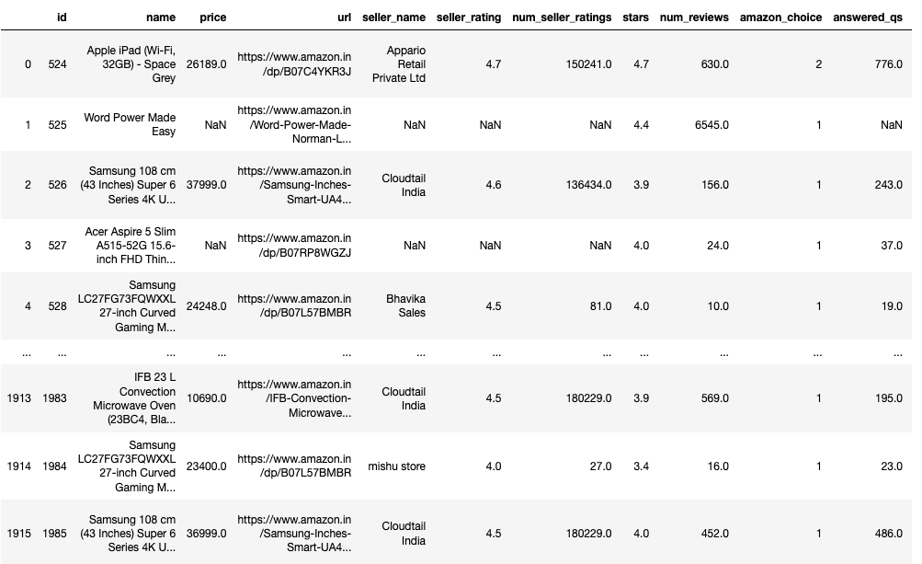

Slide 11
Cleaning the Dataset (contd.)
Gave a common name to products whose names changed during the time period
Converted time column to datetime objects and added 5 hour 30 mins to the time to convert it to IST. Set time as the index
For each product, if the price is null, replaced it with the previous value. Similarly for the number of reviews, number of answered questions, deal price, lowest price.
Replaced seller rating with the mean, for each product
Filled other values with generic values:
Brand - “No brand”
Return_policy - ”No Return Policy”
Warranty - “No Warranty”
….

Slide 12
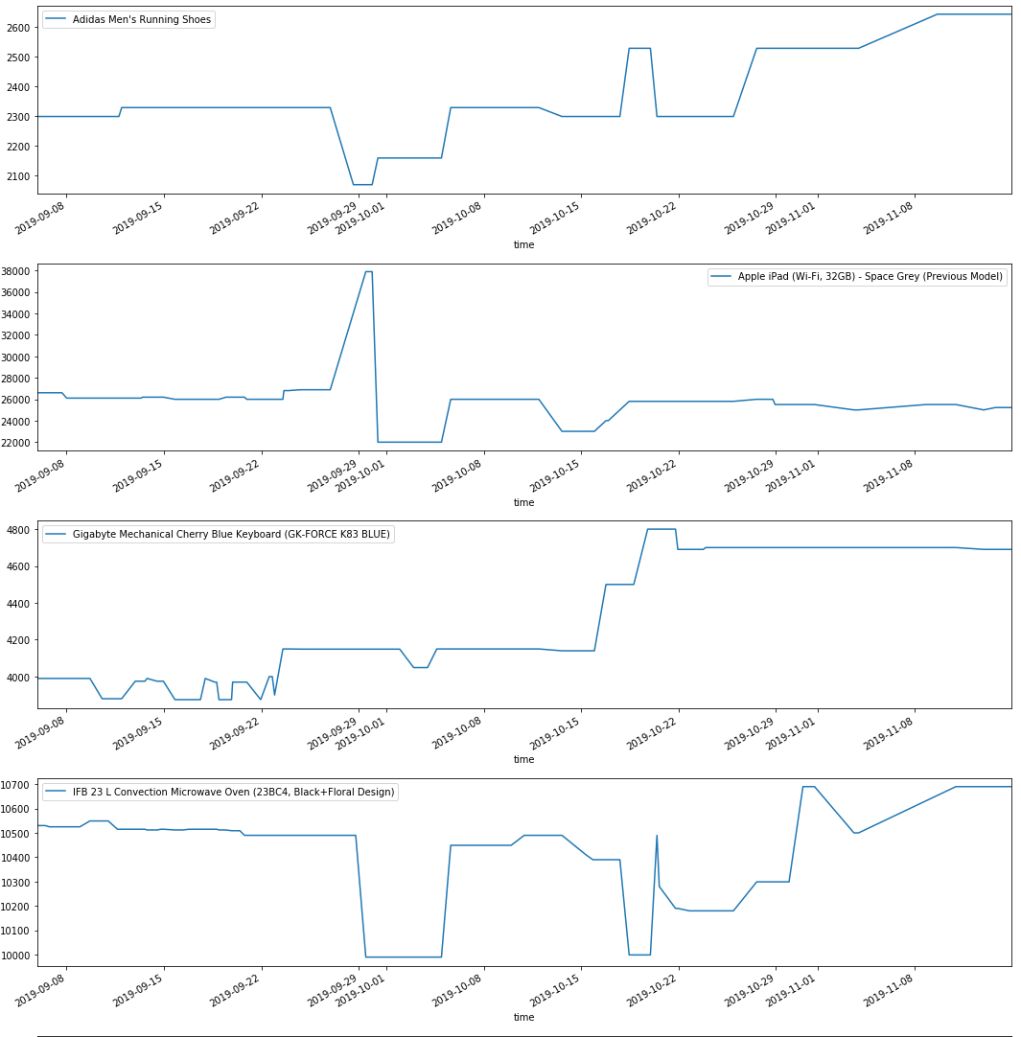
price

Slide 13
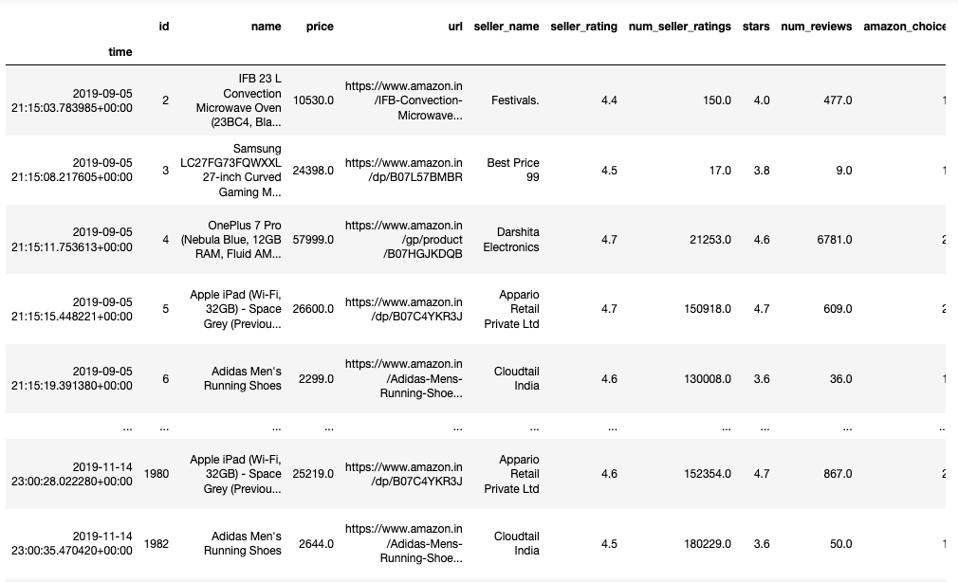

Slide 14
Normalising
Normalization is to change the values of the numeric columns in the dataset to a common scale, without distorting differences in the range of values.
Normalized price in a range of -1 to 1

Slide 15
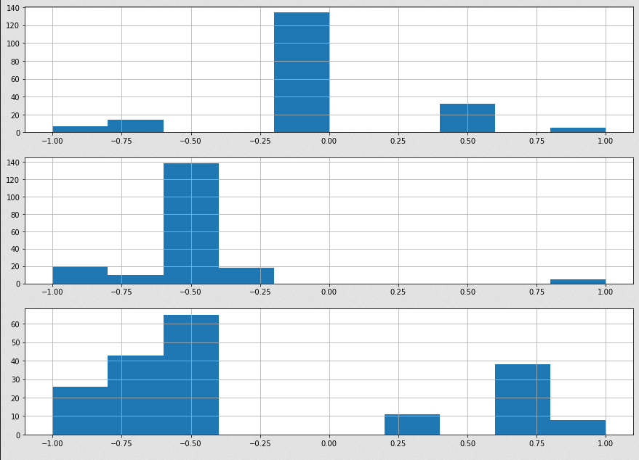
Frequency
X : price Y : frequency
Price

Slide 16
Visualisation

Slide 17
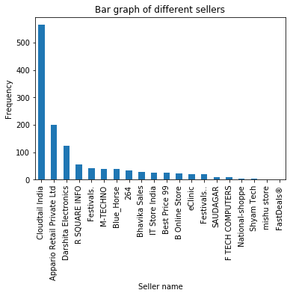

Slide 18
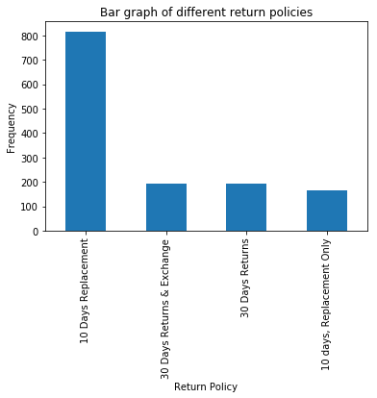
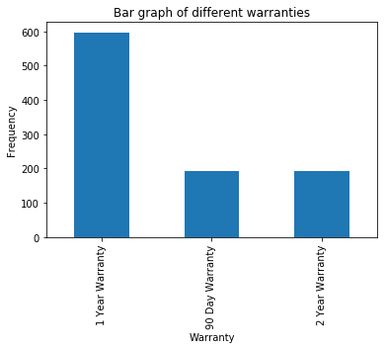

Slide 19
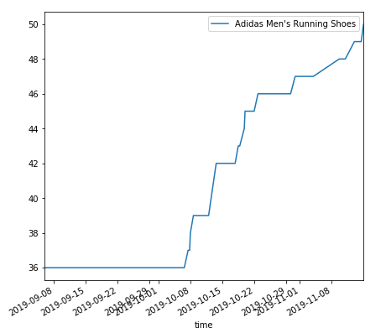
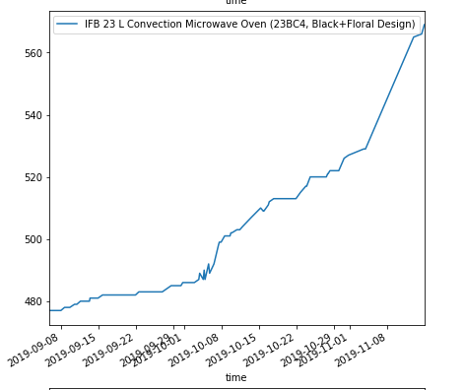
Variation of number of reviews with time (for 2 products)

Slide 20
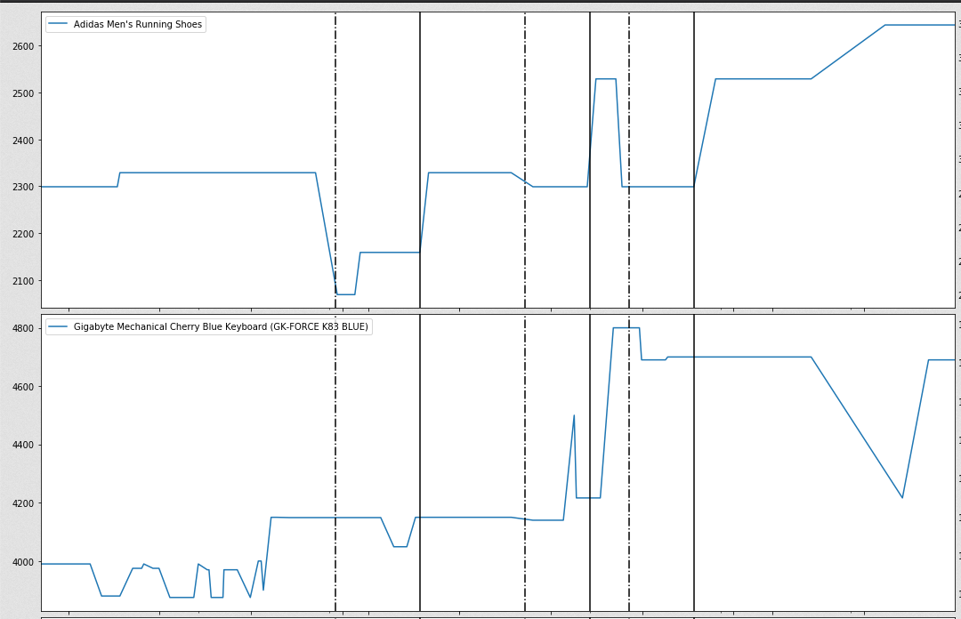

Slide 21
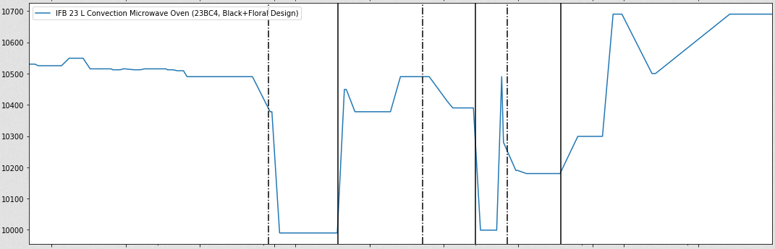
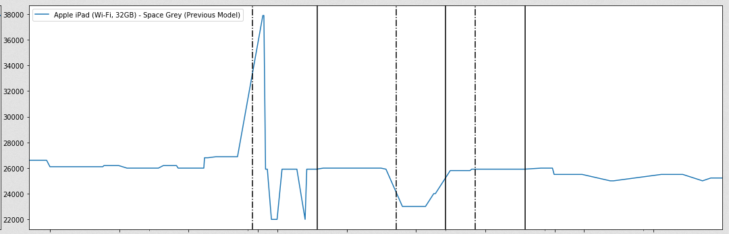

Slide 22
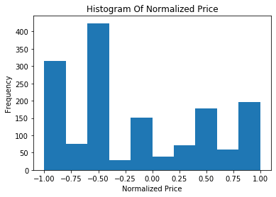

Slide 23
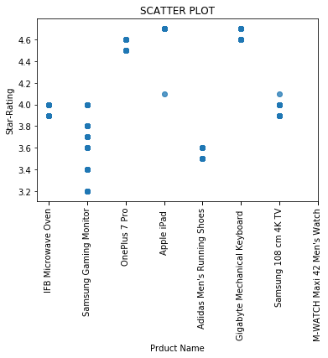
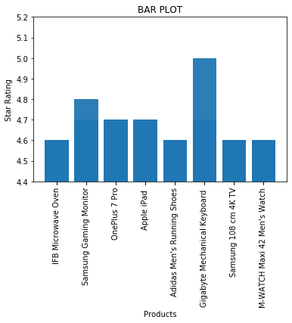

Slide 24
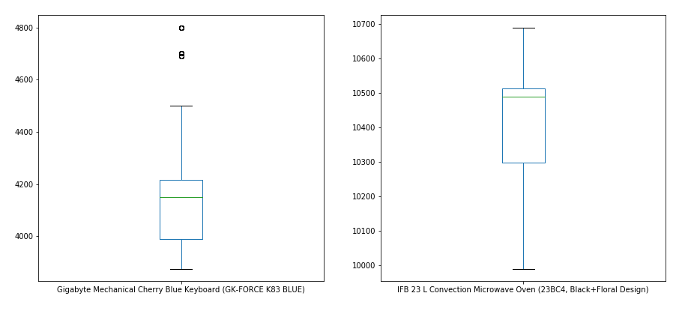
Box Plot

Slide 25
Hypothesis Testing

Slide 26
Hypothesis Testing
Hypothesis testing tells the analyst whether his primary hypothesis is true or not. Every analyst should produce two hypothesis so that any one of the hypothesis tests are true.
First Hypothesis Test:
Null hypothesis: The average value of the normalized price is 0 (i.e. price mostly stays at the mean value)
Alternate hypothesis: The average value of normalized price is less than 0 i.e., on an average, the price of a product is lesser than it’s mean

Slide 27
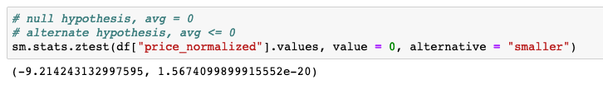
Hypothesis Testing (contd.)
After calculating the Z-score and the p-value of this test, we find that the p-value is very much less than 0.05.
Thus the null hypothesis is rejected and we can conclude that, on an average, the price is lower than the mean value.

Slide 28
Hypothesis Test 2
Null hypothesis: There is no difference between the mean values of stars (rating) for the categories “Computers & Accessories” and “Shoes & Handbags”.
Alternate hypothesis: There is a difference between the mean values of stars (rating) for the categories “Computers & Accessories” and “Shoes & Handbags”.
We use Student’s T-test for this hypothesis.
We get a t score of 14.981940916825545 and a p-value of 9.636128634908406e-51, which is very much less than 0.05.
Hence the null hypothesis is rejected and it can be concluded that there is a difference between the mean values of stars (rating) for the categories “Computers & Accessories” and “Shoes & Handbags”.

Slide 29
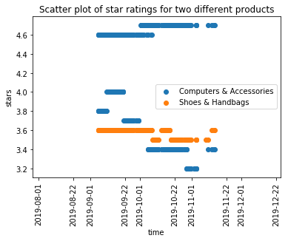

Slide 30
Hypothesis Test - 3
Null hypothesis: There is no relationship between the number of product reviews and number of seller ratings.
Alternate hypothesis: There is a relationship between the number of product reviews and number of seller ratings.
We use a Chi-Squared distribution test for this test, since the sample size is small.

Slide 31
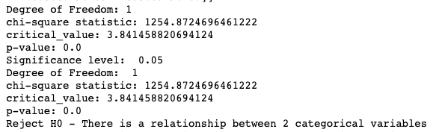
Hypothesis Test - 3 (contd.)
Results of the chi-squared test:
Since the p-value is smaller than 0.05, the null hypothesis is rejected and it can be concluded that there is relationship between number of product reviews and number of seller reviews.

Slide 32
Hypothesis test - 4
Null hypothesis: There is no relationship between the price and if the product is amazon delivered or not
Alternate hypothesis: There is a relationship between the price and if the product is amazon delivered or not
We use a Chi-Squared distribution test for this test, since the sample size is small.

Slide 33
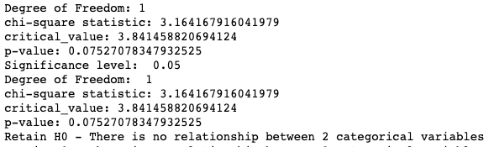
Hypothesis Test - 4 (contd.)
Results of the chi-squared test:
Since the p-value is not smaller than 0.05, the null hypothesis cannot be rejected and there is no relationship between the price and amazon delivered.

Slide 34
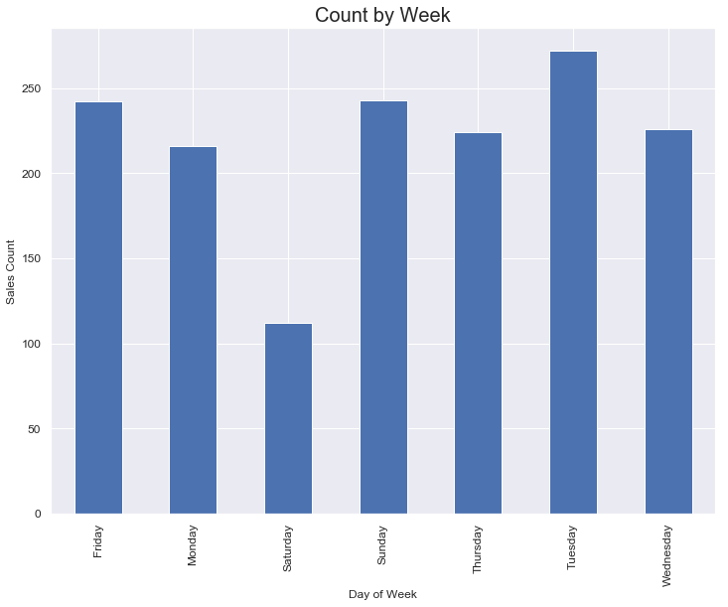

Slide 35
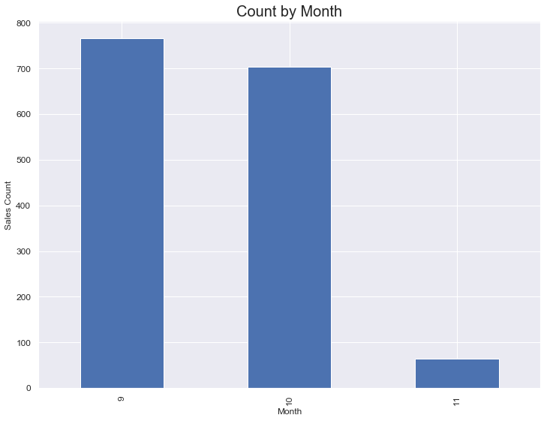

Slide 36
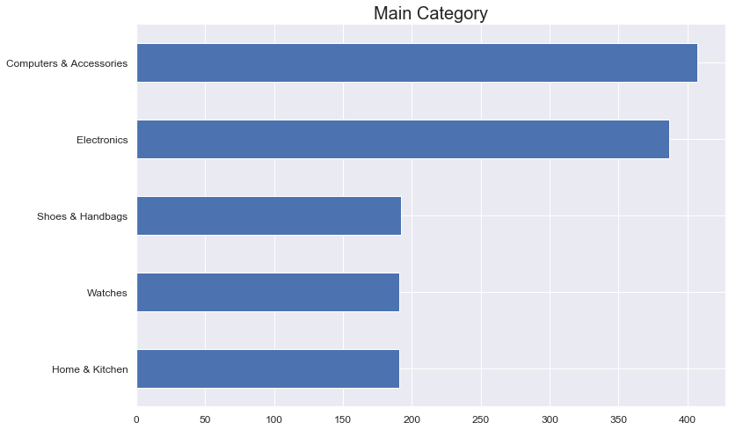

Slide 37
Correlation

Slide 38
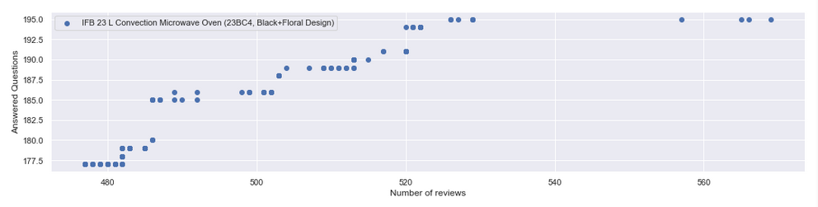
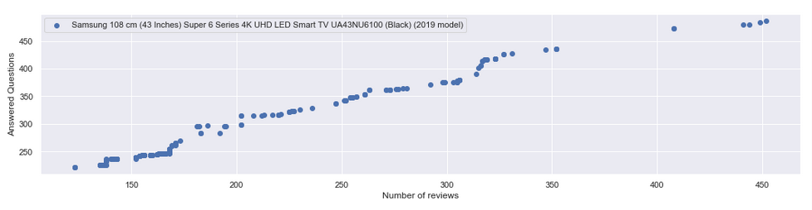

Slide 39
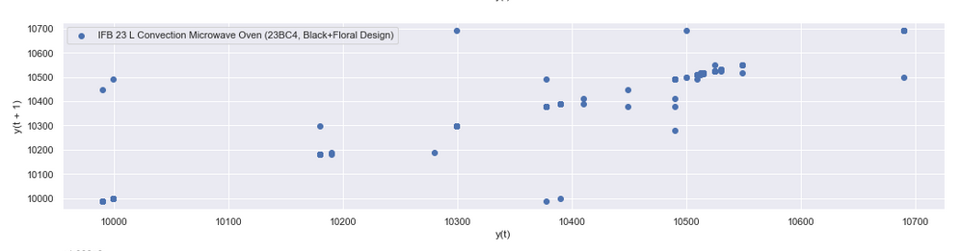
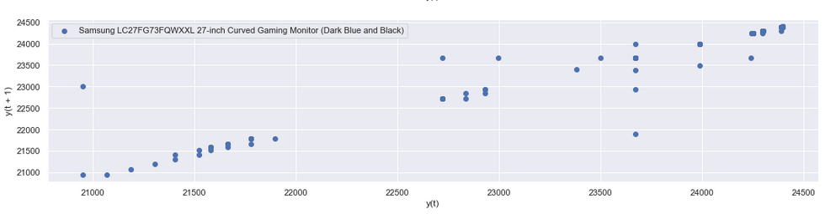
Lag Plots

Slide 40
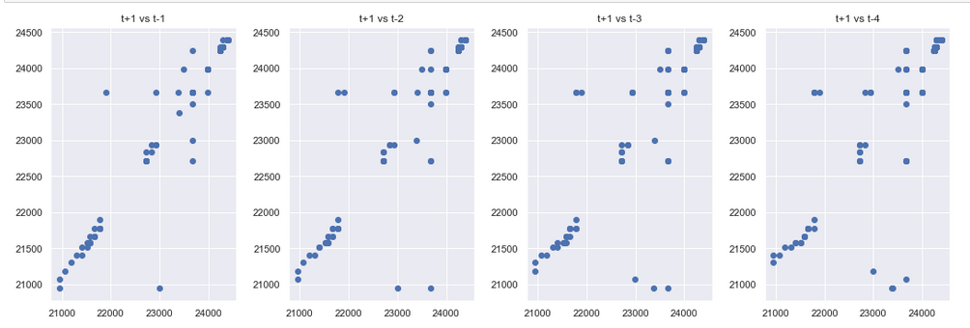
Lag plots with different times

Slide 41
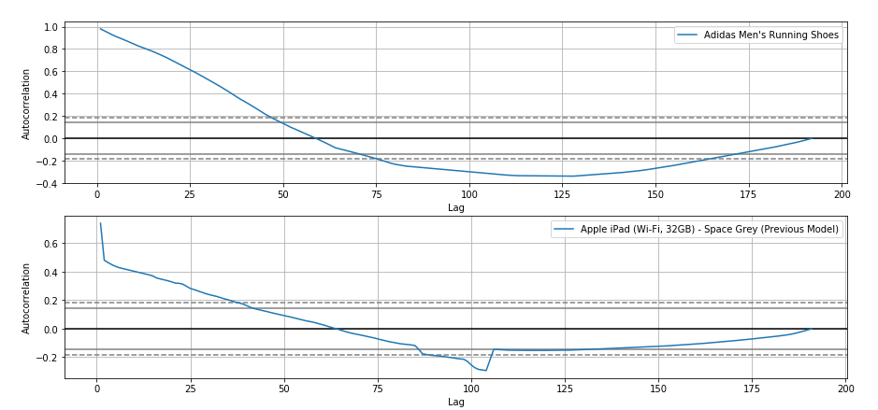
Autocorrelation plots of number of reviews for 2 products

Slide 42
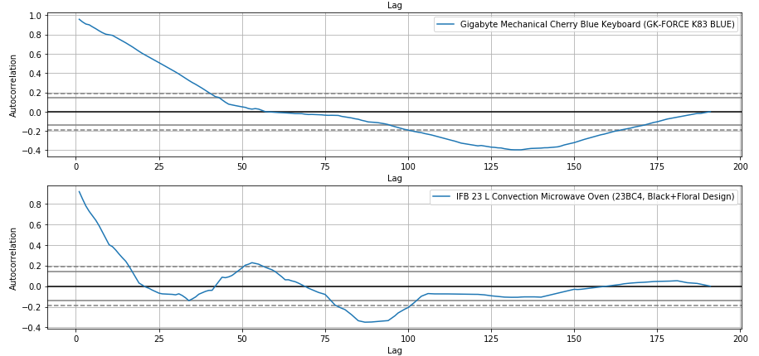
Autocorrelation plots of price for 2 products

Slide 43
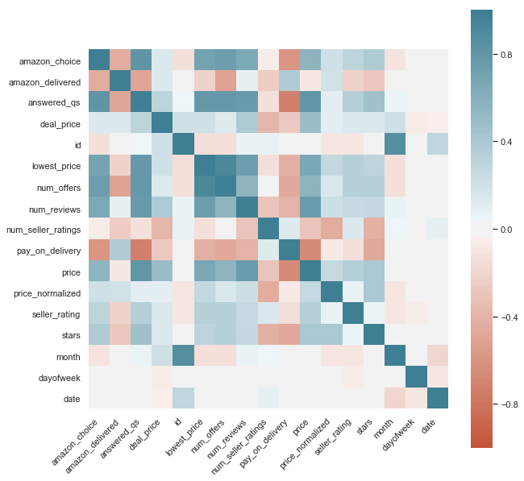
Heatmap of correlation coefficients for each column.

Slide 44
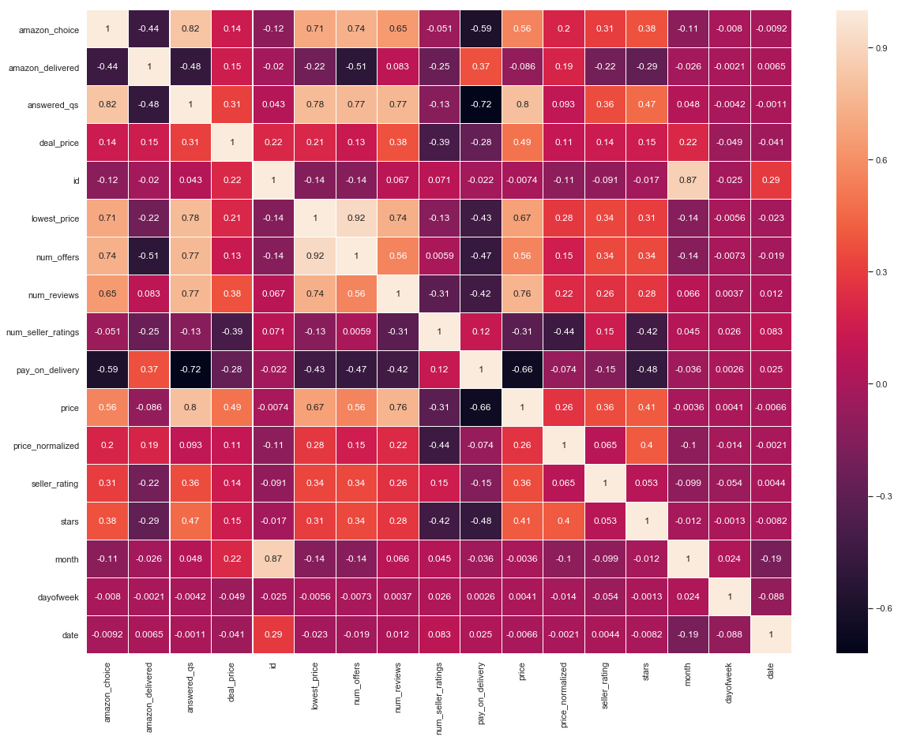

Slide 45
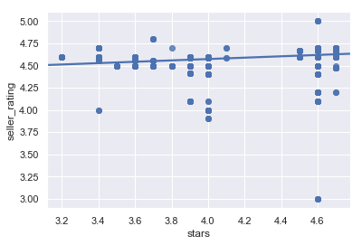
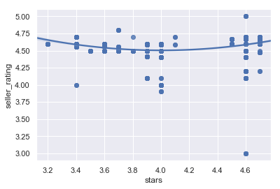
Linear regression with seller rating and product rating. This shows a weak linear relationship.
Regression of second order with seller rating and product rating.

Slide 46
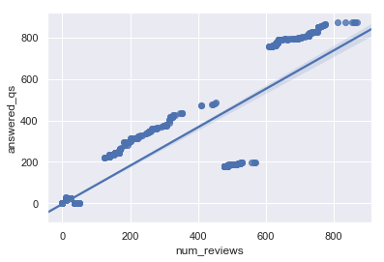
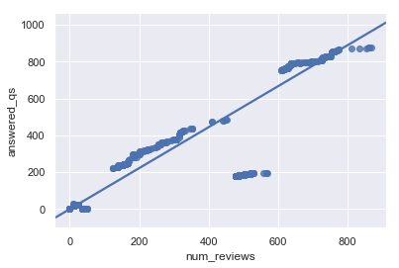
Linear regression with number of reviews and number of answered questions. This shows a strong linear relationship.
Linear regression with number of reviews and number of answered questions, using a model which is more robust against outliers.

Slide 47
References
Amazon India - amazon.in
Scrapy documentation - https://docs.scrapy.org/en/latest/
PostgreSQL in SQLalchemy - https://docs.sqlalchemy.org/en/13/dialects/postgresql.html
SQLalchemy documentation - https://docs.sqlalchemy.org/en/13/
Heroku - https://devcenter.heroku.com/categories/reference
Pandas
Matplotlib
Seaborn
Jupyter Notebook
Numpy
Statsmodels API
Scipy

Slide 48
Thank You!

